Slide 1
COLLECTIVE INTELLIGENCE COLLECTIVE PATH FINDING
Prucs Ákos
enpcte@inf.elte.hu

Slide 2
Motivation
Come up with a game
Implement an enviroment
See what behaviour the agents implement
Image(s)
2024. 01. 12.
2

Slide 3
Environment
Path finding, teamwork, 2D
Blue dots: agents
Green circle: their range of vision
Red dot: the goal to find
Agents signal whether they have found the goal yet
… the only way of communication
End: p% agents reached goal or time limit
Image(s)
test run on random policy
2024. 01. 12.
3

Slide 4
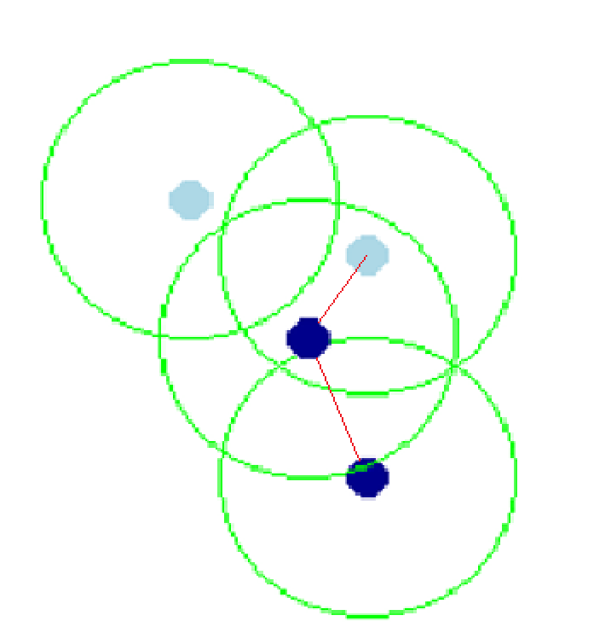
Observation spaces
Two variants:
They see everything (inside vision)
They see top k closest object
Fellow agent is represented by three number: (rel_x, rel_y, goal)
‚goal’ – bit changing between 0 and 1
2024. 01. 12.
4

Slide 5
Rewards
3 variants:
Coll. reward only at the end at succession.
Coll. reward each time agent find the goal
Individual rewards on finding the goal
Reward is usually 1.
Penalty on time limit reached.
2024. 01. 12.
5

Slide 6
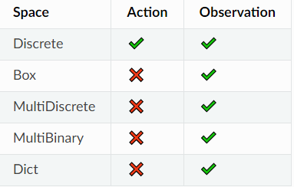
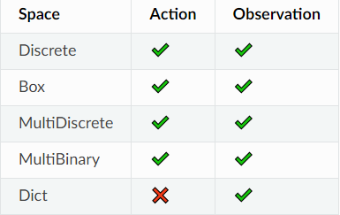

Action spaces
Single discrete action space w/ 8 possible values
…representing 8 possible direction
sb3 dqn
sb3 ppo
8 possible direction ranging from 0-7
2024. 01. 12.
6

Slide 7
Testing on different rewards and observatin types
Simplified enviroment
smaller map
Trained for a few iterations only
few minutes
Evaluation metric: game timestamps
On average how much time it took to complete the task
DQN
PPO
A2C
everything
everything
everything
observation
top k
top k
top k
reward s.
at end
523 | 538
513 | 516
497 | 527
476 | 500
503 | 483
508 | 504
510 | 504
544 | 482
474 | 546
508
at each finding
506
individual
509
511 527 495 495 509 510
2024. 01. 12.
7

Slide 8
Early runs
they get stuck
stays in one place
close to random
overfit on a specific movement
2024. 01. 12.
8

Slide 9
Finally - better runs, findings on behaviour
overfitting on goal being on the side
learn a specific movement to cover the entire map
stay around the destination to signal its presence
use of communication
Notes:
9

Slide 10
Thank You for Your attention!
Prucs Ákos
enpcte@inf.elte.hu
Questions?
2024. 01. 12.
10

